Slide 1
Why Engineers Do Presentation?
Introduce new ideas for approval
Share information
To convince his customers / bosses
Report the progress of project
Wrap up a project

Slide 2
What are you trying to achieve at the end of your presentation?
To inform the assessors of the key aspects of your project work.
To convince the assessors that you have done a good job.

Slide 3
What to impress?
You need to convince the assessors that you have:
clearly understood of your roles in the project.
chosen a right approach/solutions to the research/problems.
achieved the targets set by the project/supervisor.
tried your best, applied what you have learnt from your course and contributed to the project.
made full used of the 12 weeks given and you have benefited from your project works.

Slide 4
What the contents will be?
Introduction/background of the project
The objectives
The scope of works
The specifications
The design/solutions
Results/findings/Testing/evaluation
The conclusion
The comments/suggestions
The project planning
Q & A

Slide 5
Introduction/Background
What is this project about?
Why carry out this project work?
What is the benefit or value-add?
Any similar projects being done before and what has been achieved?
It’s a new or extension of previous project?

Slide 6
The objectives
At the end of the project:
What are you trying to achieved?
What are the deliverables?

Slide 7
The scope of works
What are the tasks that you need to do in order to achieve the objectives set?

Slide 8
Project Specifications
What are the key features required?
What are the prototype specifications?
What are the user requirements?
Note: the specifications usually are measurable.

Slide 9
The design/solutions
What are the different design concepts that considered?
Explain your solution
Use drawing for mechanical design.
Use circuit diagrams for electrical design.
Use flowchart or functional block diagrams for software design.

Slide 10
Results
The outcomes/findings
Testing and evaluation

Slide 11
The conclusion
Summarise the major outcomes of the project work.
Have you completed all tasks as planned?
Is your design/solution works?
If yes, what is the performance?
If No, Why?
What have you learned from the project?

Slide 12
The comments/suggestions
Main problems encountered
How did you overcome this problems
Your feedback or suggestion for improvement

Slide 13
The project planning
Show tasks to be completed in 12 weeks.
Show the project plans in Gantt Chart.
Indicate the milestone and project completion date.

Slide 14
Q & A
Ask audience for questions
Leave enough time of questions
Know your project well - every part of it!

Slide 15
Tips for good presentation
Dress appropriately
Should not limit to just using powerpoint slides, consider using other effective visual aids.
Bullet point list, few words on each slide
Speak clearly and loudly
Logical flow
Do not try to give lecture
Using pointer or pen, have good eye contact.
Label the drawings and diagrams clearly and give them titles
Keep with the times allocated
More practices

Slide 16
Sample Slides

Slide 17


InstantCab
Xxx Group
Student: xxx
Supervisor: xxx
Notes:
Good morning. I am LinChengCheng. My project title is instantCab

Slide 18

Content
Problem
Project Objective
Solution
System Setup
Technologies & Tools
Database Design
Functional Modules / Features
Challenges / Solutions
Benefits
Demo
Conclusion
18
Notes:
In the presentation I will show you the problems we are facing when we book the taxi. Then I will show you my project objective,solution,followed by system set up, technologies & tools, database design, Functional Modules, challenges, benefits, recommendation, demo and conclusions

Slide 19
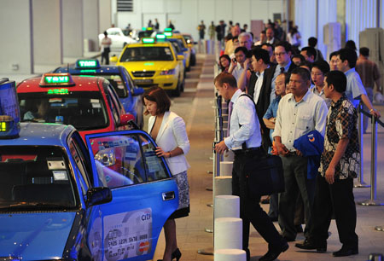
Background
Busy Phone Lines
Overcome Long Taxi Queues
Unhappy about the current taxi booking services
Notes:
In our current life, the taxi booking hotlines are always very busy, people have to wait for a long time to book the taxi. And sometimes they have to queue a long queue to wait for the taxi at taxi stand. So quite a lot of people are unhappy about the current taxi booking services.

Slide 20
Objectives
Enables commuters book a cab without calling the hotline of each individual taxi companies.
Allows taxi drivers from all the companies to register and view all the commuters’ booking and accept the booking from their mobile phones.
Notes:
The instantcab application allows commuters to book a cab without calling the hotline of each individual taxi companies and it also allows taxi drivers from all the taxi companies to register and view all the commuters’ booking and accept the booking from their mobile phones.

Slide 21
Solution - InstantCab Mobile Application
Commuters:
Edit Profile
Book cab
View Pending Booking Detail
Rate the services
Notes:
The application allows commuters to edit their profiles, book cab, view pending booking details and rate the services.

Slide 22
Solution - InstantCab Mobile Application
Taxi Drivers:
Edit profile
View pending bookings
Accept bookings
Notes:
And It also allows taxi drivers to edit their profiles, view pending bookings and accept bookings

Slide 23
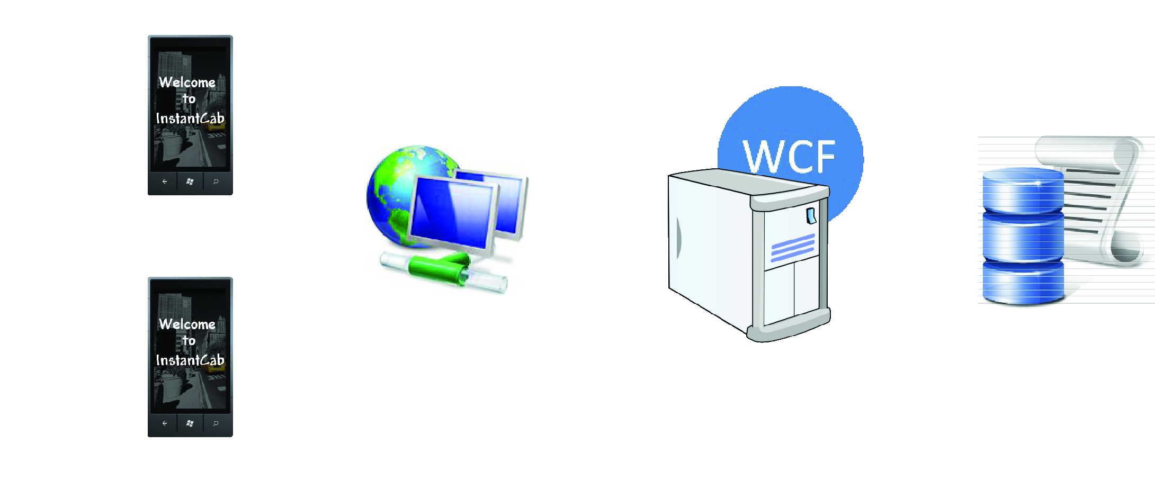
Workflow & Architecture
3 tier Architecture
SQL
Application tier
Data tier
Client tier
Notes:
So this is our 3 tier architecture of my project. We store our data into SQL database, then we use our windows phone to consume the wcf service to pull and retrieve data from database

Slide 24

Technologies and Tools
Software:
Microsoft Silverlight
Microsoft Expression Blend 4
Microsoft Visual Studio 2010
Adobe Photoshop CS5
Adobe Illustrator CS5
Hardware:
Window Phone
Database:
Microsoft SQL 2008
SQL Server Management Studio
Notes:
So in my project I will use silverlight, expression blend4, visual studio 2010, photo and illustrator, and I will also use sql 2008 and sql server management studio

Slide 25
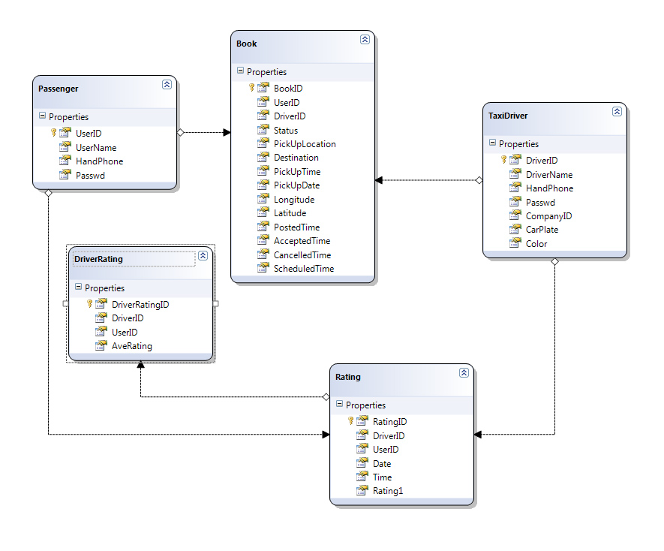
Database Design

Slide 26
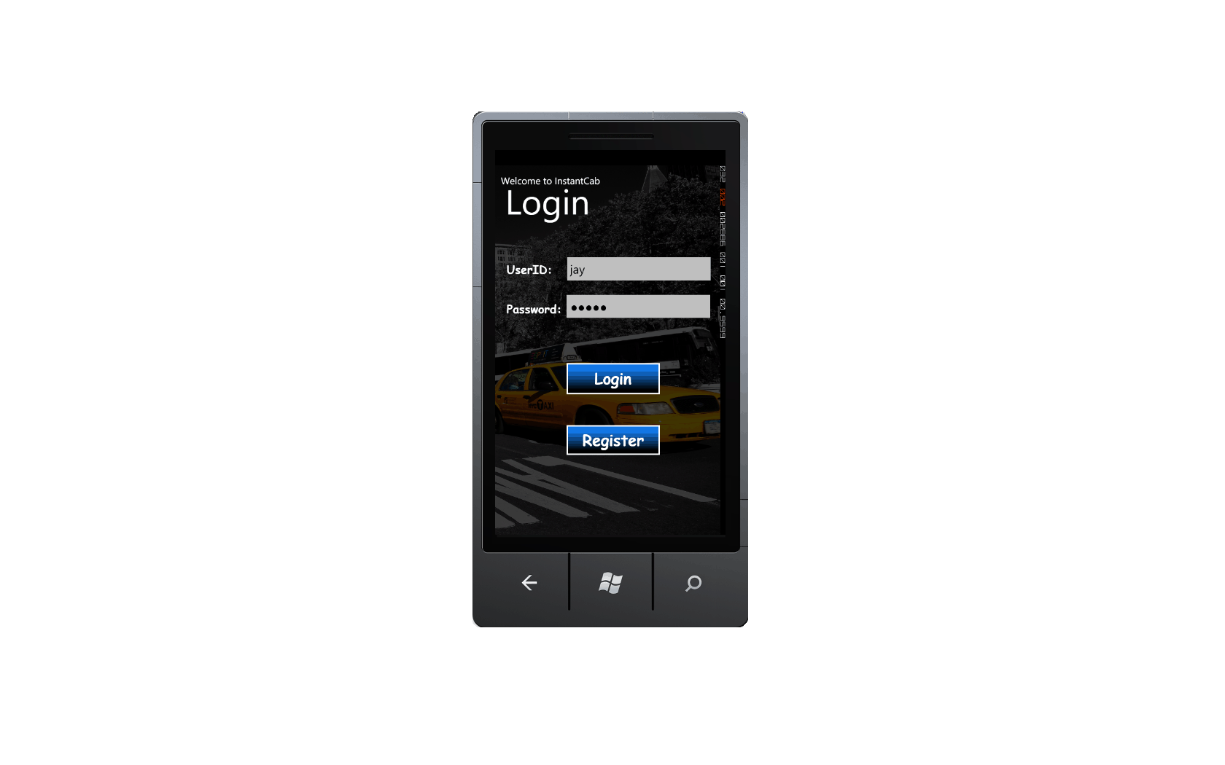
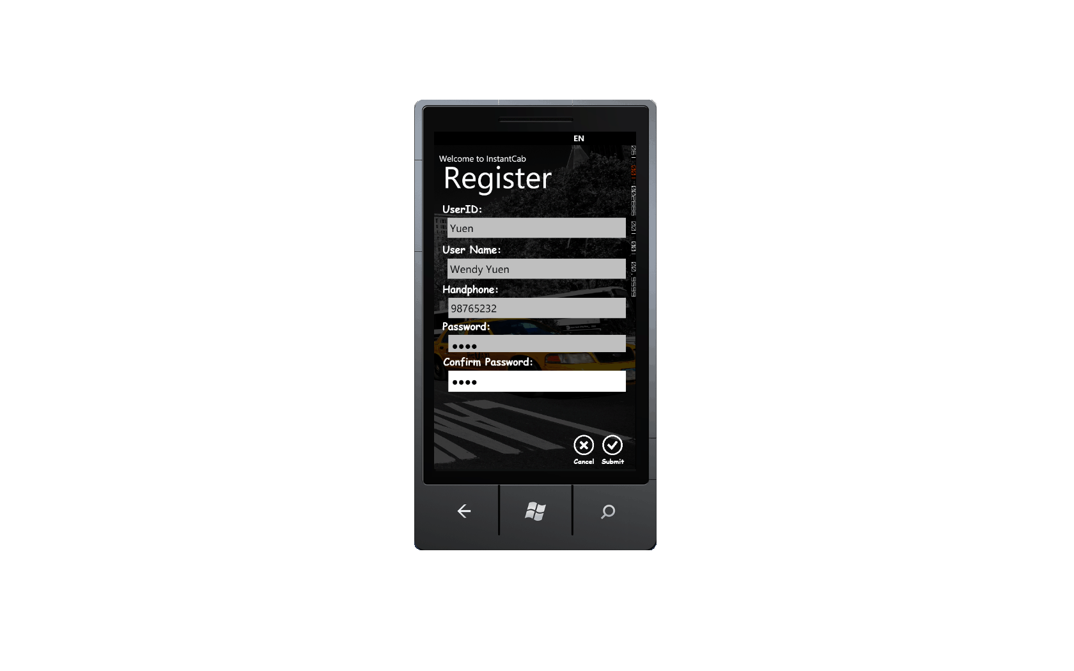
Features
Login Authentication
Registration
Edit profile
Booking
View booking
Accept Booking
Feedback
Notes:
My project has seven main features. Registration, login authentication, edit profile, booking ,view booking , accept booking and feedback

Slide 27

Benefits
Convenient for Taxi Driver and Users
View booking information and accept booking very quickly
Doesn’t need to dial taxi companies’ service number
Notes:
The benefit of my application is its very convenient, for the user they no need to dial taxi companies’ service number, for the driver they will view the booking information and accept the booking very quickly

Slide 28
Demonstration
☺
28

Slide 29
Project Schedule
To insert relevant
portion of
project schedule

Slide 30
Conclusion
Architecture Firmed Up
Database Design Done
2 out of 7 features Completed & Tested
Project is on track as planned

